Slide 1
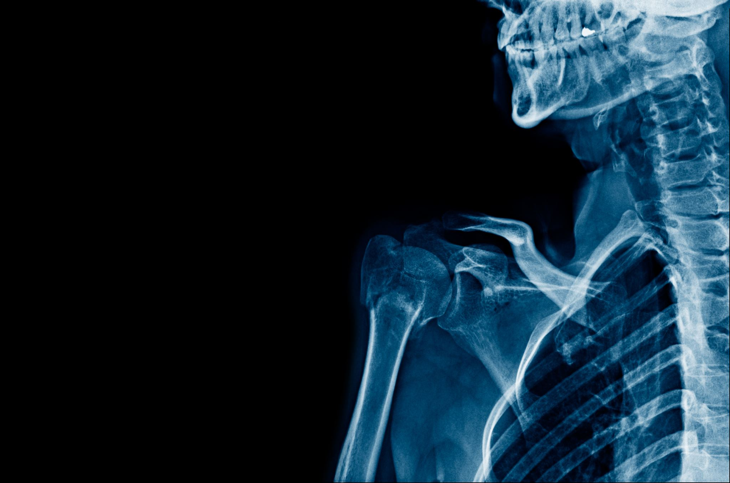
Basic principles of trauma
Contents :
Definitions
Orthopedic terminology and fracture classification
Bone structure and healing
General Principles of fracture management
Complications of fractures

Slide 2
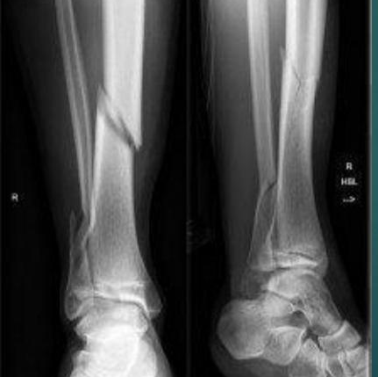
Fracture:
Is a break in the continuity of bone substance.

Slide 3
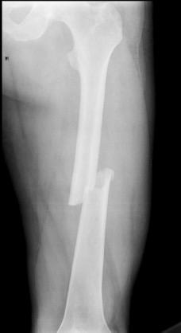
Diaphyseal fracture
fracture of shaft of long bones

Slide 4
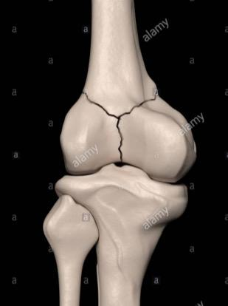
Intra- articular fracture
fracture that involves the articular surface of a bone.

Slide 5
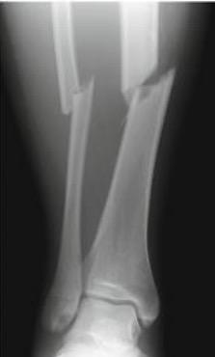
Simple fracture
The bone is broken into two fragments only.

Slide 6
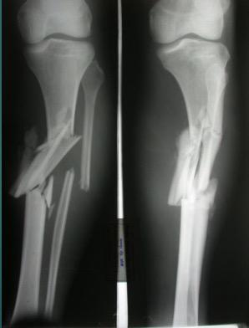
Comminuted fracture
Bone is broken into more than two fragments

Slide 7
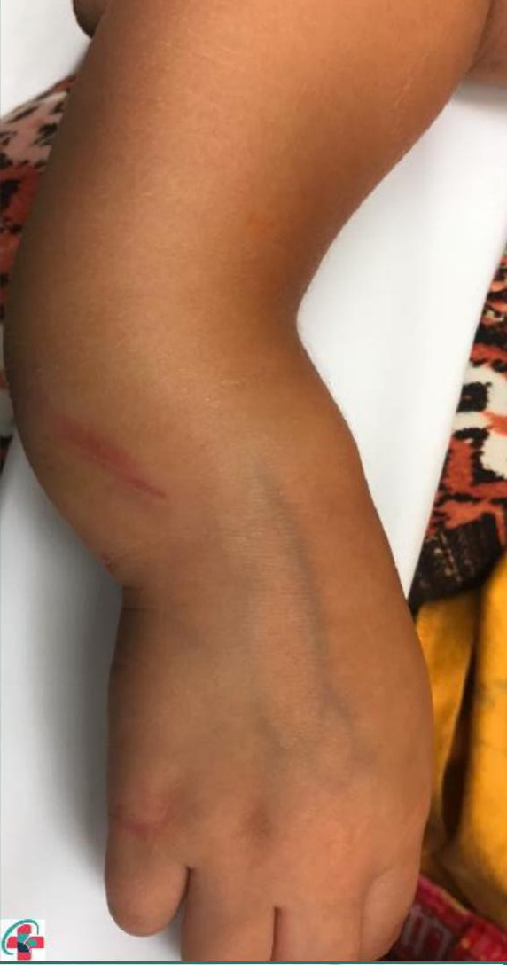
Closed fracture
fracture with intact skin or with superficial wounds.

Slide 8
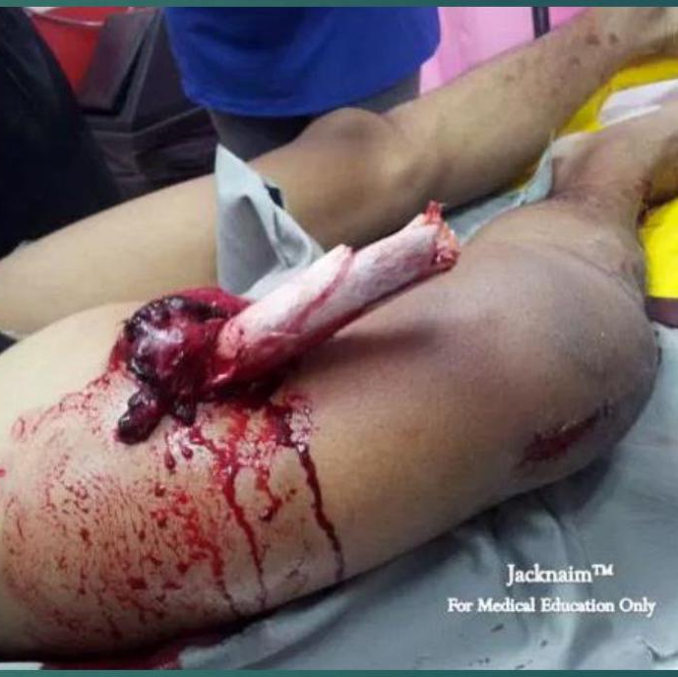
Open fracture
fracture associated with a wound communicating the fracture hematoma with the exterior.

Slide 9
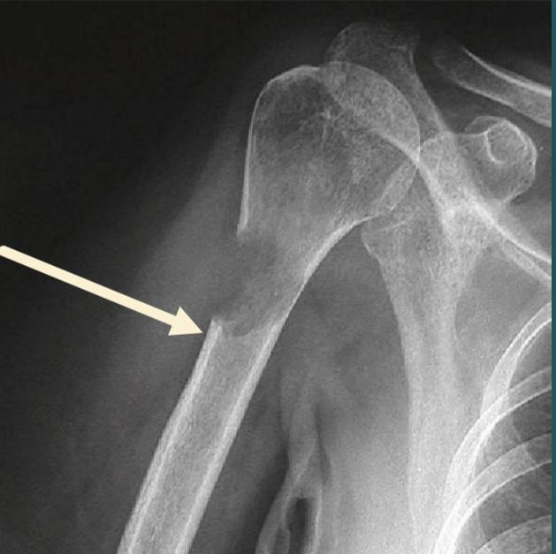
Pathological fracture
Is a fracture occurring in a diseased or abnormal bone. It occurs after trivial trauma as the force needed to produce fracture is markedly reduced.

Slide 10
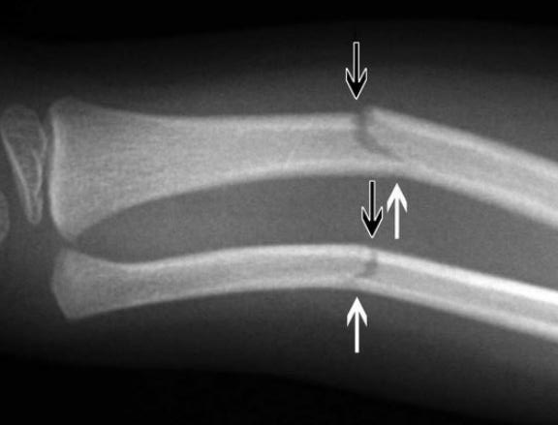
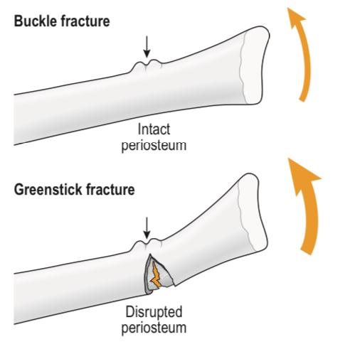
Greenstick Fracture
incomplete fracture that occurs in children. One cortex breaks, the other bends and its covering periosteum remain intact.

Slide 11
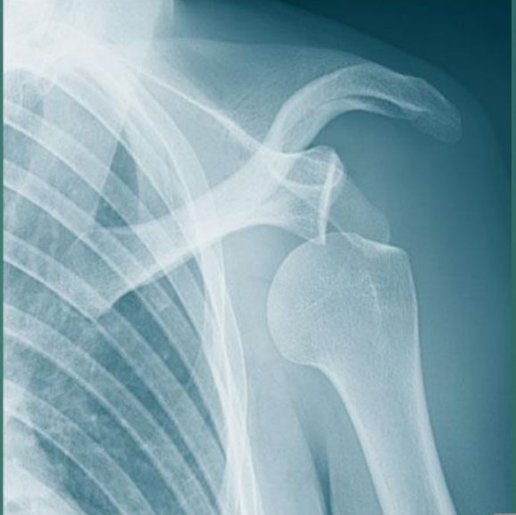
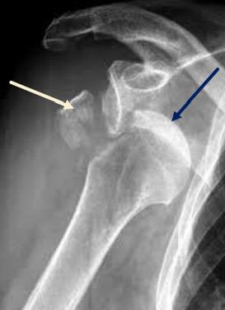
Dislocation
Fracture Dislocation
The two articulating surfaces of a joint are no more in contact.
Is a dislocation associated with a fracture of one or more of the articulating bones.

Slide 12
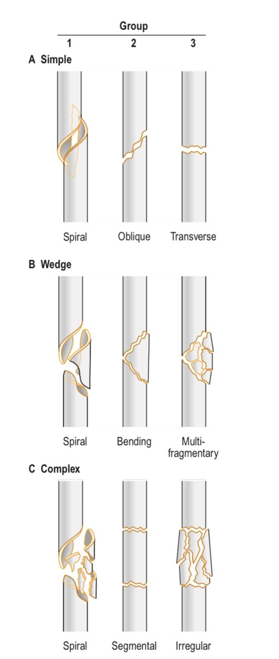
Classification of shaft fractures

Slide 13
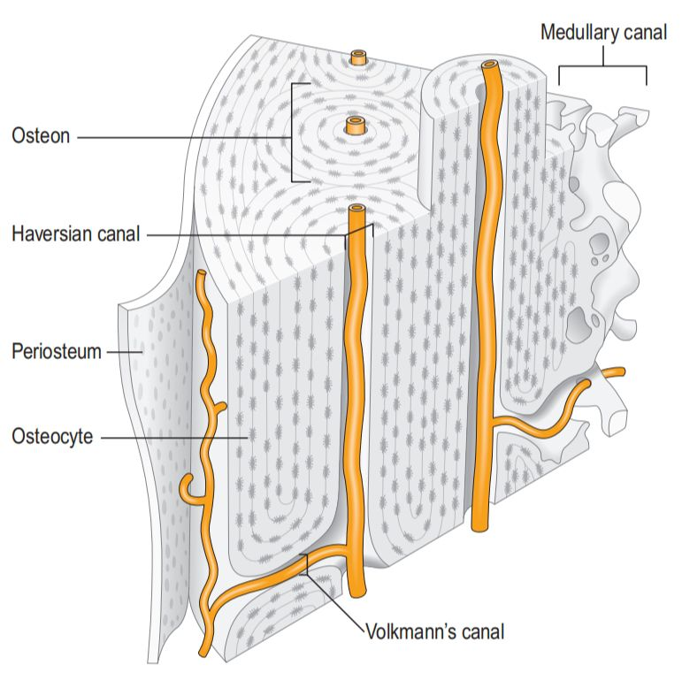
Bone anatomy
Cortical bone is made up of components termed osteons.
At the core of the osteon is a central Haversian canal containing blood vessels. Around the canal is a series of concentric lamellae or rings of bone matrix, embedded within which are the bone cells: osteocytes.
Adjacent osteons communicate via channels termed Volkmann’s canals.

Slide 14
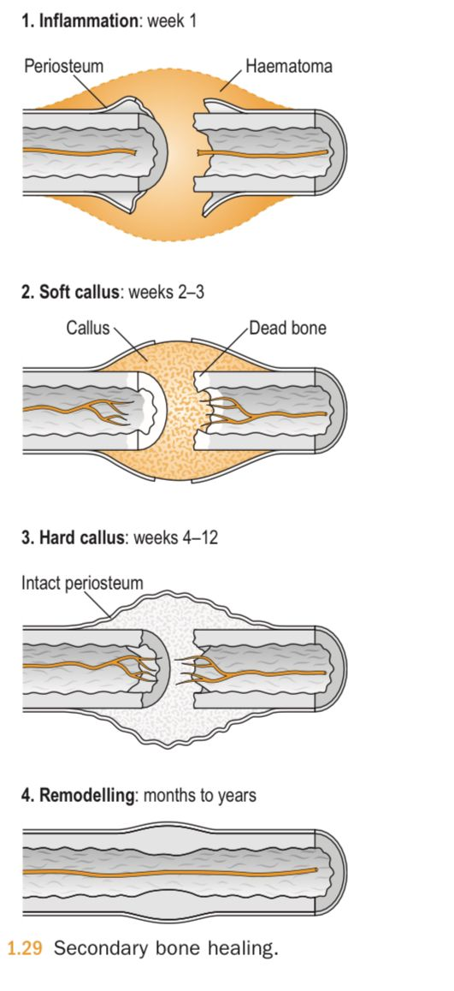
Secondary bone healing
(healing with callus )
four phases:
Inflammation (week 1).
Soft callus (weeks 2–3).
Hard callus (weeks 4–12).
Remodeling (months to years).

Slide 15
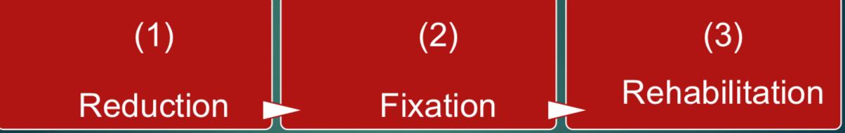
GENERAL PRINCIPLES OF FRACTURE MANAGEMENT

Slide 16
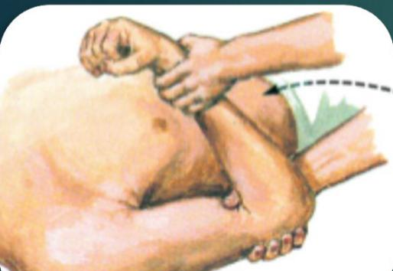
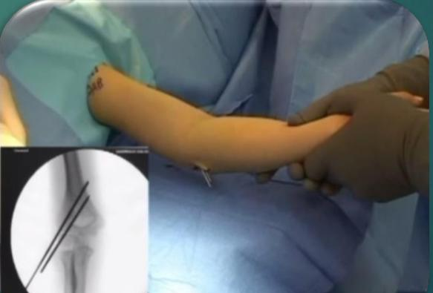
REDUCTION
Closed ( indirect )reduction
Open ( direct )reduction

Slide 17
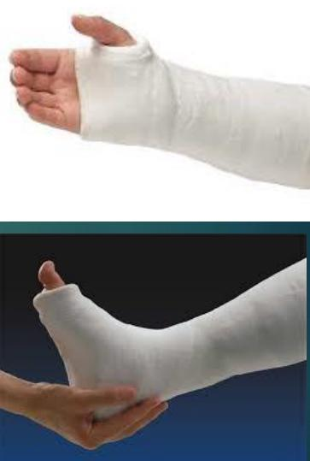
Plaster Cast
( plaster of Paris )
widely used especially for most children’s fractures
complication
Tight cast
Pressure sores
Loose cast

Slide 18
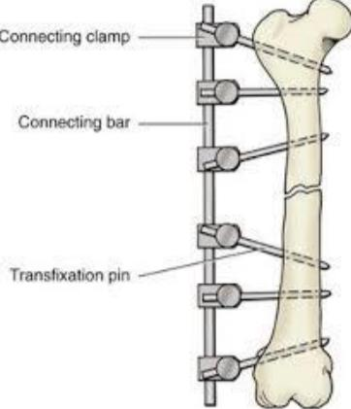
External Fixation
Indications
Open fractures III with extensive contaminated wounds
In polytrauma to stabilize fractures in minimal time
Open book pelvic fractures
Disadvantages
injury of nerves and vessels.
Pin track infection.
Loosening of the pins.
Transfixion of muscles resulting in stiffness of joints.

Slide 19
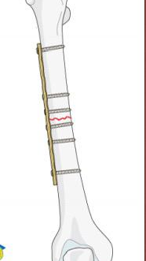
Internal Fixation
Indications:
1. Diaphyseal fractures that cannot be closely reduced.
2. Displaced intra-articular fractures.
3. Fractures of radius and ulna in adults.
4. Displaced epiphyseal fractures.
5. Fractures in multiply injured patients to facilitate nursing.
6. Hip fractures in elderly patients to allow early mobilization of the patient.
7. Pathological fractures.
8. Fractures associated with neurovascular injuries.

Slide 20
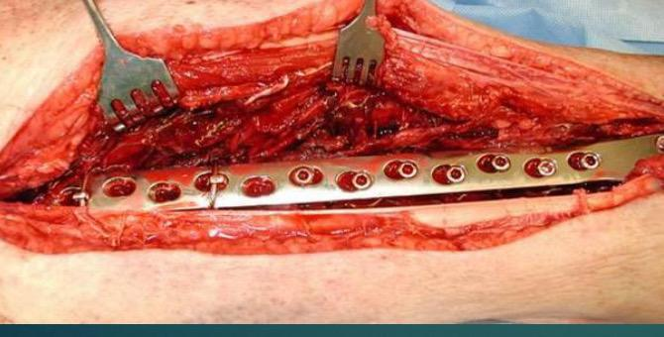
Internal Fixation
Advantages:
Anatomical reduction
Stable fixation. stripping delay union
Pain-free early joint motion
Early functional recovery
Disadvantages:
Risk of infection
Soft tissue
Implant failure

Slide 21
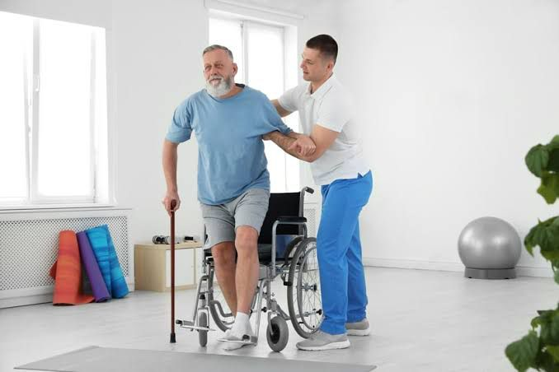
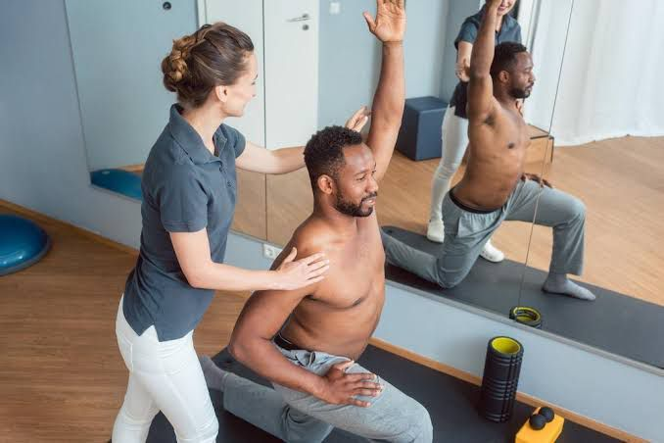
REHABILITATION

Slide 22
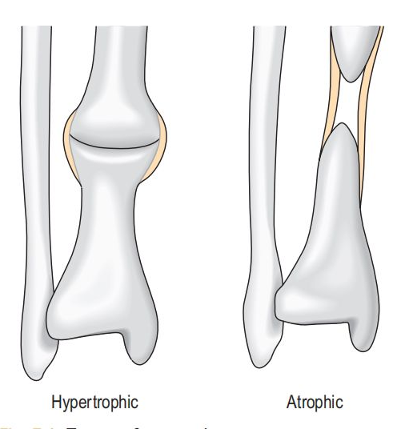
Complications of fractures
NON-UNION
Hypertrophic non-union: a mechanical problem due to inadequate fracture stability.
Atrophic non-union: a biological problem due to reduced or absent fracture healing activity, which may relate to any of the patient factors outlined above.

Slide 23
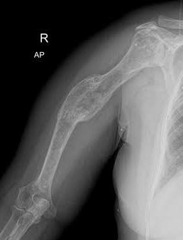
Complications of fractures
MALUNION
Malunion is healing of a fracture in a non-anatomical position. This may result from inadequate initial reduction, or from subsequent loss of reduction, which may itself relate to inadequate initial stabilization of the fracture.

Slide 24
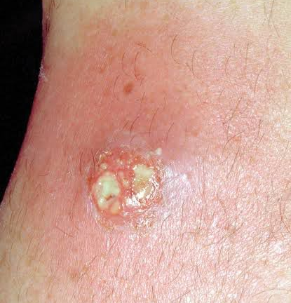
Complications of fractures
INFECTION
Delay fracture healing and needs :
Assessment of blood indices of inflammation.
Wound debridement
Antibiotic treatment

Slide 25
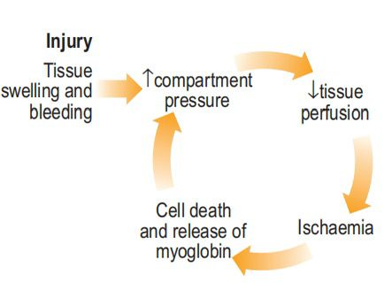
Complications of fractures
COMPARTMENT SYNDROME
This catastrophic complication occurs after blunt injury to a group of muscles enclosed in a tight fascial compartment.

Slide 26
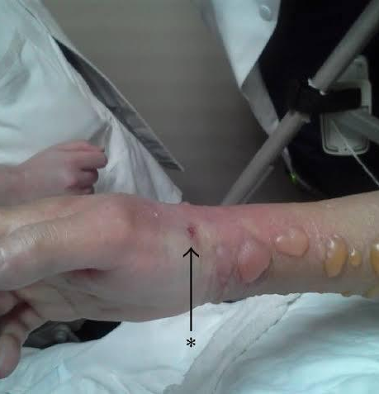
Complications of fractures
COMPARTMENT SYNDROME
If this condition is suspected early, immediate splitting of the plaster cast or dressings and extension of the flexed joint are done. If pain persists, incision of the skin and deep fascia overlying all compartments in the affected part is done to relieve tension.

Slide 27


